Slide 1
What is E-Waste?
Personal Experiences and the Bigger Picture

Slide 2
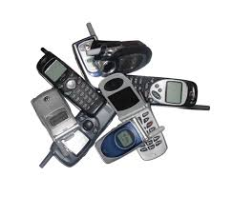
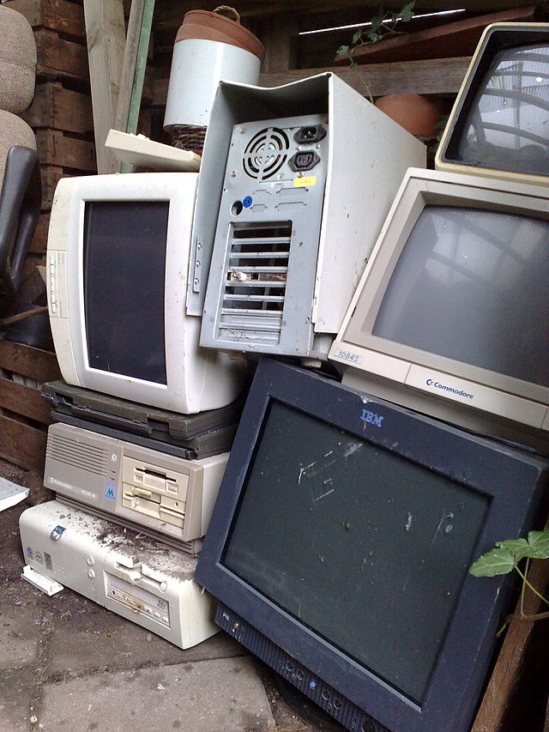
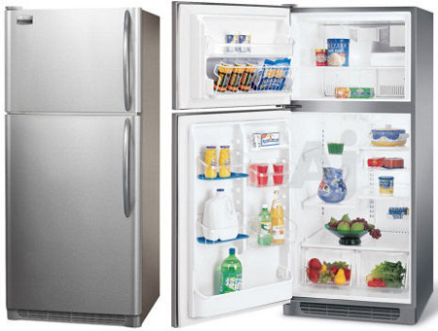
‘E-Waste’ stands for Electronic Waste. This includes….
Notes:
"Electronic waste" may be defined as discarded computers, office electronic equipment, entertainment device electronics, mobile phones, television sets, and refrigerators.

Slide 3
Where does E-Waste come from?
Internally from Households and Small Businesses
Internally from Companies, Institutions and Governments
Externally from Countries Illegally dumping non-reusable electronics
Notes:
An estimated 50 million tons of E-waste are produced each year.^{[1]} The USA discards 30 million computers each year and 100 million phones are disposed of in Europe each year. The Environmental Protection Agency estimates that only 15-20% of e-waste is recycled, the rest of these electronics go directly into landfills and incinerators

Slide 4
What are Problems with E-Waste?
Health Hazards
- Lung Cancer
- DNA damage
- Chronic damage to brain
Environmental Hazards
- Ground-water Pollution
- Air Pollution
- Acidification of soil (plants/crops will not grow or lose their nutrients)
- Lead and heavy metals in ground (end up in plants/crops and thus in animal and human bodies.)
Notes:
Informal processing of electronic waste in developing countries may cause serious health and pollution problems, as these countries have limited regulatory oversight of e-waste processing.
Electronic scrap components, such as CRTs, may contain contaminants such as lead, cadmium, beryllium, or brominated flame retardants. Even in developed countries recycling and disposal of e-waste may involve significant risk to workers and communities and great care must be taken to avoid unsafe exposure in recycling operations and leaking of materials such as heavy metals from landfills and incinerator ashes.

Slide 5
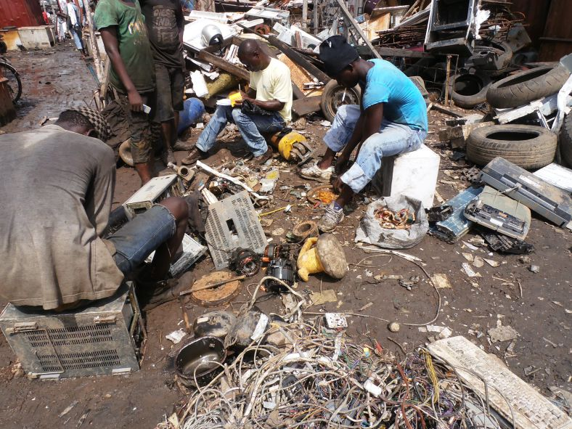
E-Waste Workers in Agbogbloshie

Slide 6
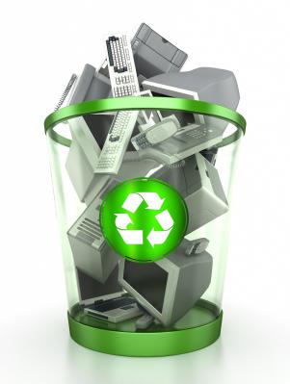
How can we Rethink E-Waste?
Recycling….
Notes:
This involves finding the breaking down and scraping of materials within e-waste. This is often what happens in sites like Agbogbloshie. Workers are extracting the salvageable materials within the E-waste and sending them to factories to be processed. Much how when plastics or glass bottles are recycled they are melted down and reprocessed for new use.
Takes a lot of energy at the end, though. Can be quite costly and as already demonstrated there are environmental hazards for the informal scrapers and recyclers on the other end of manufactoring

Slide 7
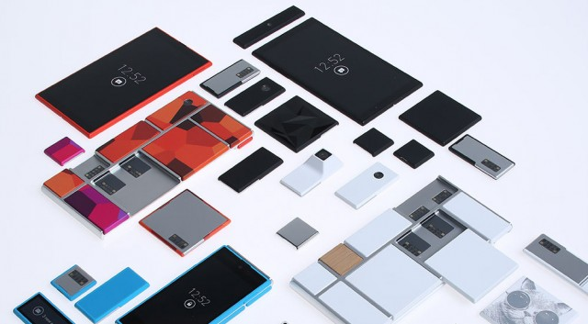
How can we Rethink E-waste?
Design against things breaking easily…
Notes:
It turns out that Motorola has had the same idea. Called Project Ara, Motorola’s R&D department is working on an “open hardware platform for creating highly modular smartphones,” with the aim of doing for hardware what Android has done for software.
The problem with this is even the component (small parts that make up the cellphone) need to be changed out

Slide 8
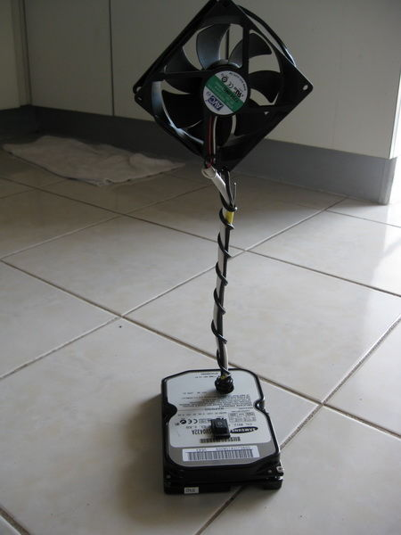
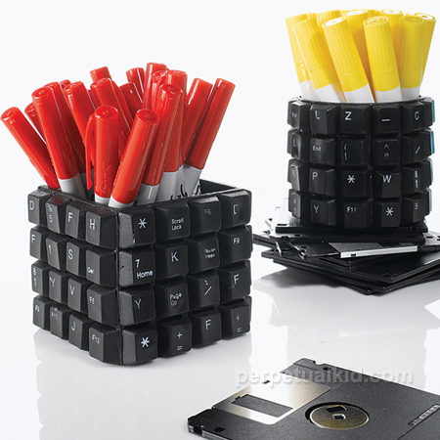
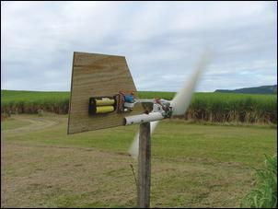
How can we Rethink E-Waste?
Upcycling, Reuse and Generate!
Notes:
Which means reusing materials to make a new object with a new purpose, often with a personal and creative touch. We will be working in this realm of dealing with E-waste for our project. Using working component parts of E-waste to make a new helpful device.

